Slide 1
Bike Demand Project
<Natalie>
<Jun 13, 2025>

Slide 2
Executive Summary
Objective: Predict bike-sharing demand pattern using weather, city and season data
Build regression models for demand forecasting.
Source:
Wikipedia: Extracted a global bike-sharing systems dataset.
OpenWeatherMap API: Collected real-time and 5-day weather forecasts for five global cities (Seoul, New York, London, Tokyo, Paris).
IBM Cloud Object Storage: Downloaded structured datasets.
SQLite: Centralized all datasets for SQL querying and aggregation.
Cleaning and Prepration
- Removed embedded references and standardized column names across all datasets.
Extracted numerical values from descriptive fields (e.g., bike counts).
Merged and stored cleaned datasets in a SQLite database for efficient querying.
SQL analysis and Predictive Modeling

Slide 3
Introduction
The project investigates how weather conditions and seasonal trends impact the usage of bike-sharing systems.
Bike-sharing is growing rapidly as a sustainable urban mobility solution. The usage patterns are not consistent, they vary significantly based on weather conditions, time of day and seasons
By building predictive models based on historical usage and real-time weather data, cities can improve operations, optimizing bike availability, reducing maintenance downtime and supporting environmental goals

Slide 4
Methodology
Data Collection
Data Wrangling & Cleaning
Exploratory Data Analysis (EDA)
Predictive Modeling
Dashboard App Development

Slide 5
Methodology

Slide 6
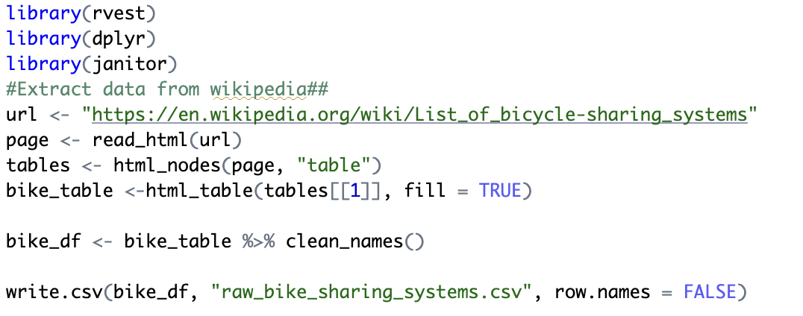
Data collection
Scraped bike-sharing system data from Wikipedia
Retrieved real-time and 5-day weather data using OpenWeatherMap API
Downloaded datasets from IBM Cloud: bike usage, weather, and city demographics

Slide 7
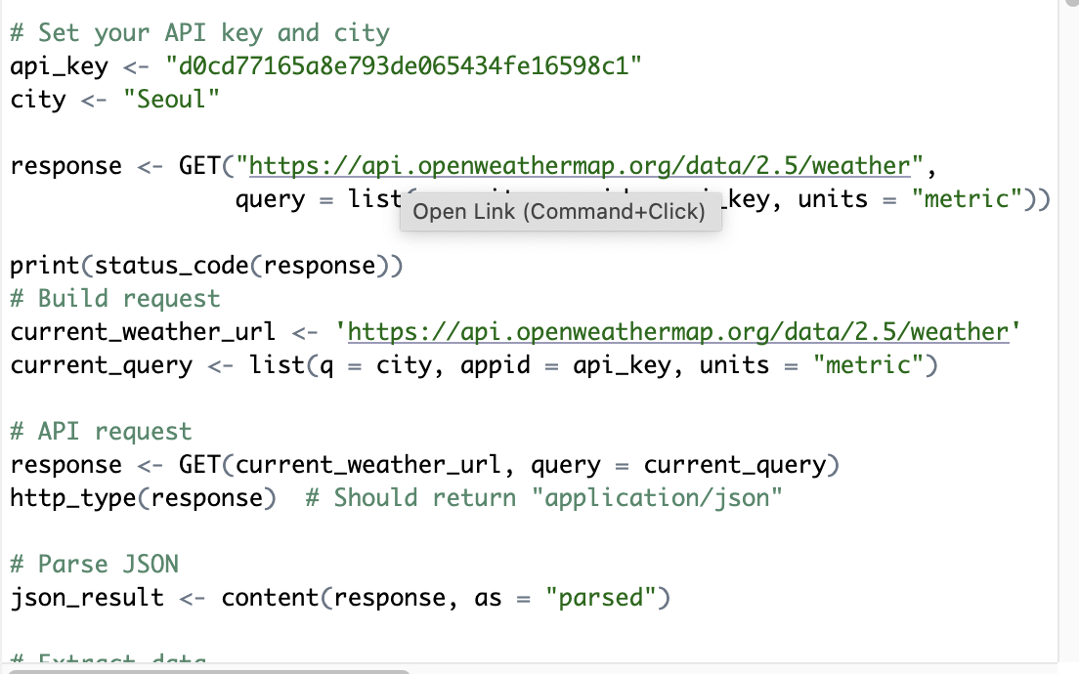

Slide 8
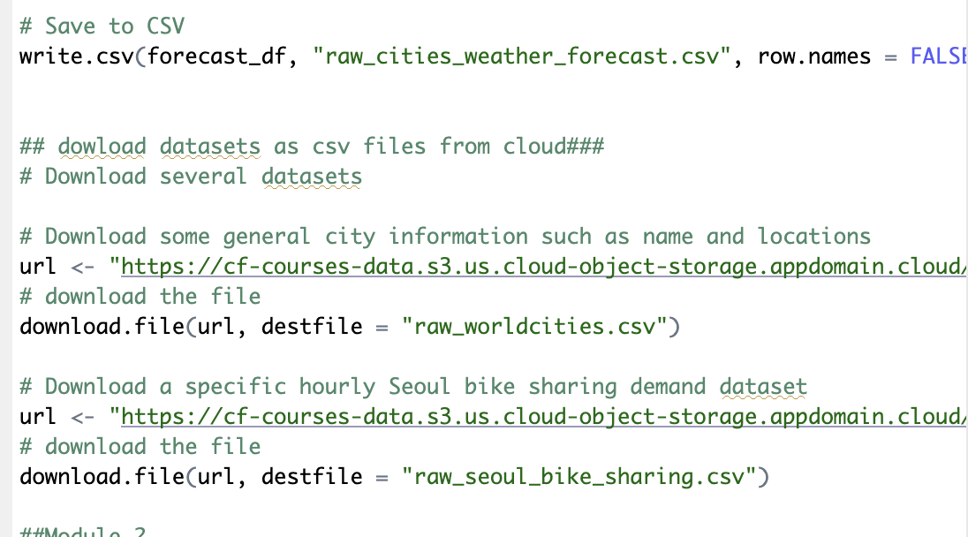

Slide 9
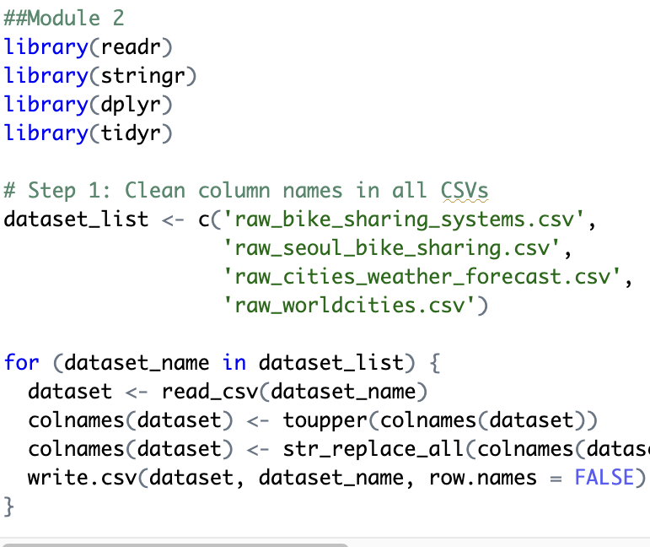
Data wrangling
Standardized column names and formats
Removed noisy characters, reference links, and extracted numeric values
Stored clean datasets in an SQLite database for efficient querying

Slide 10
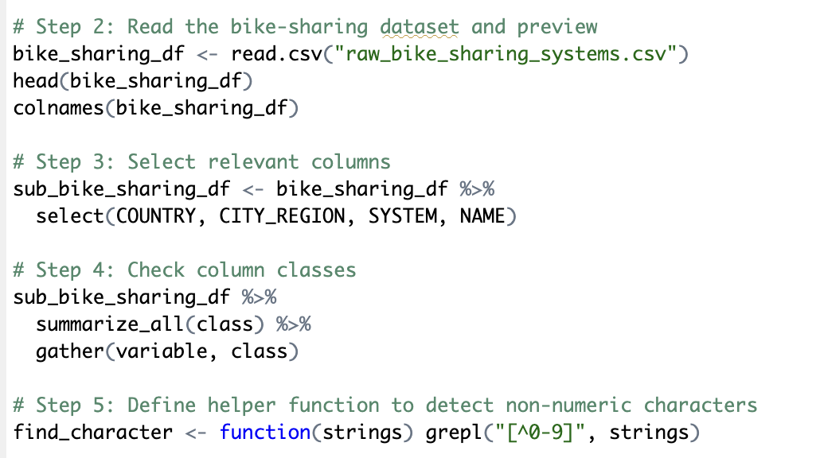

Slide 11
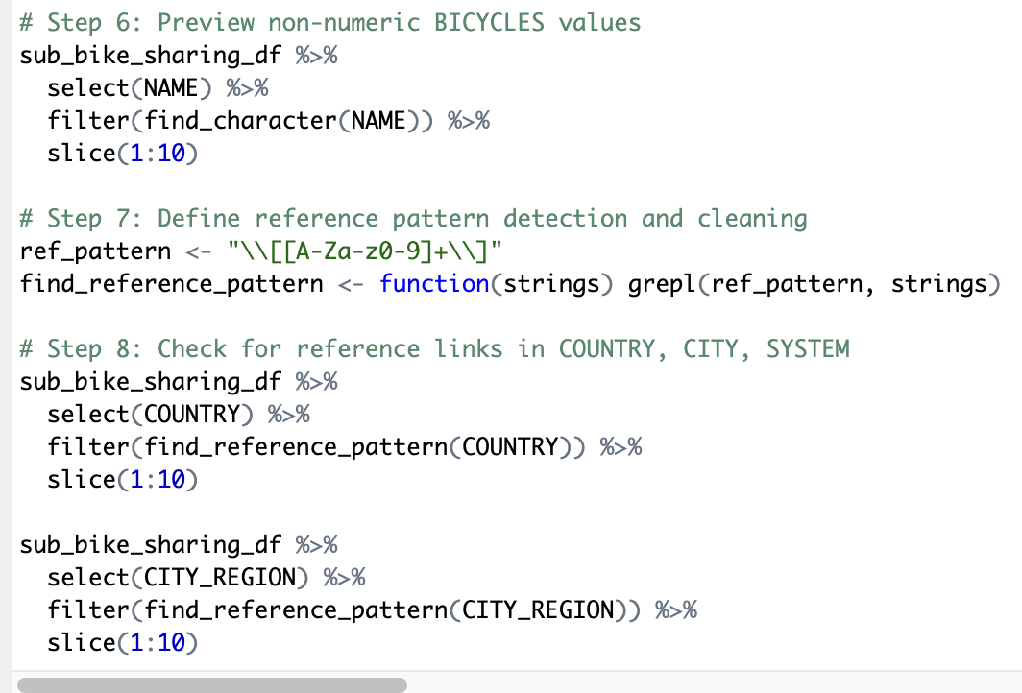

Slide 12
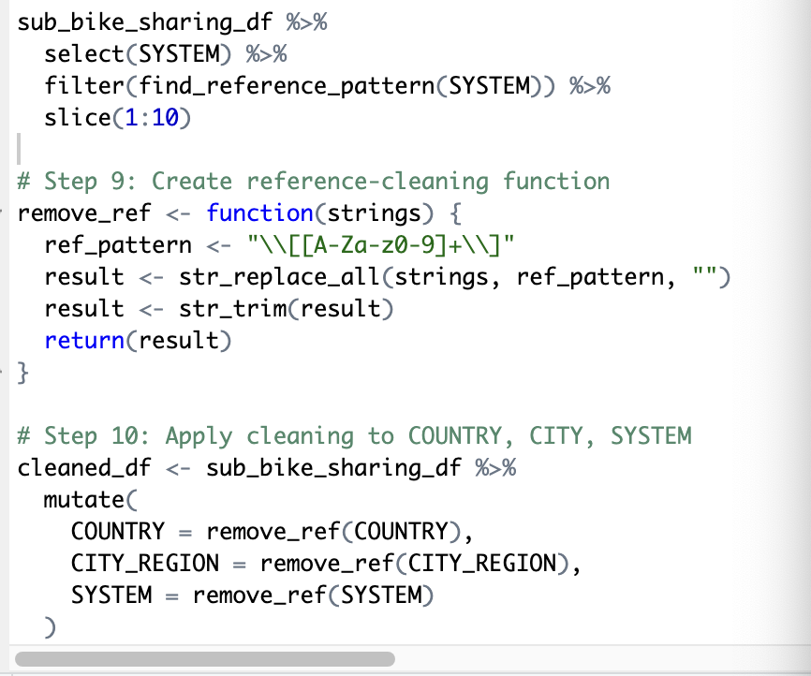

Slide 13
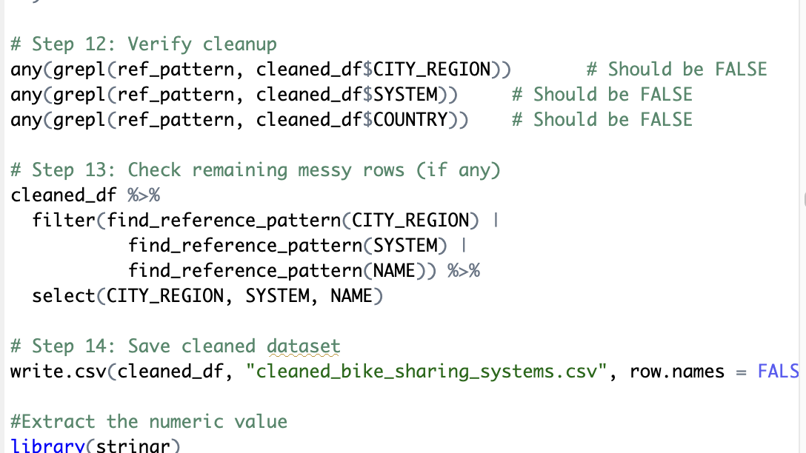

Slide 14
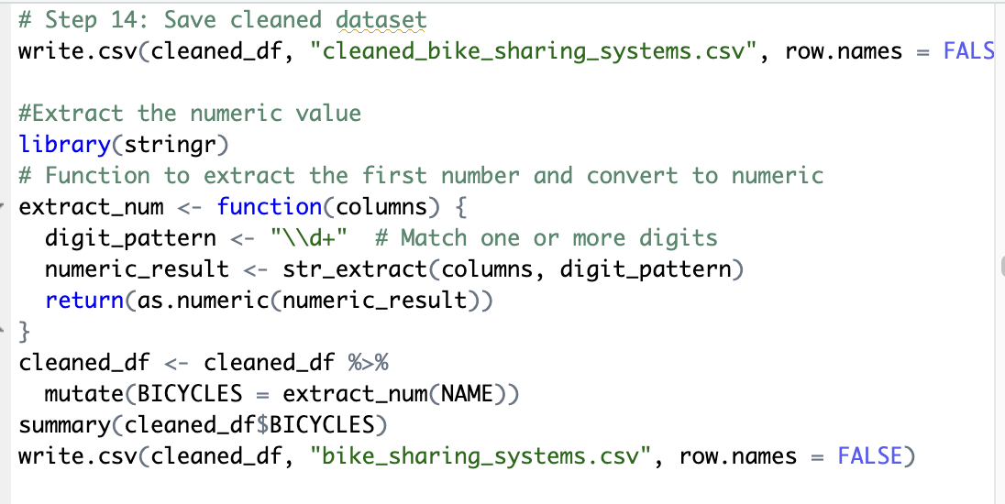

Slide 15
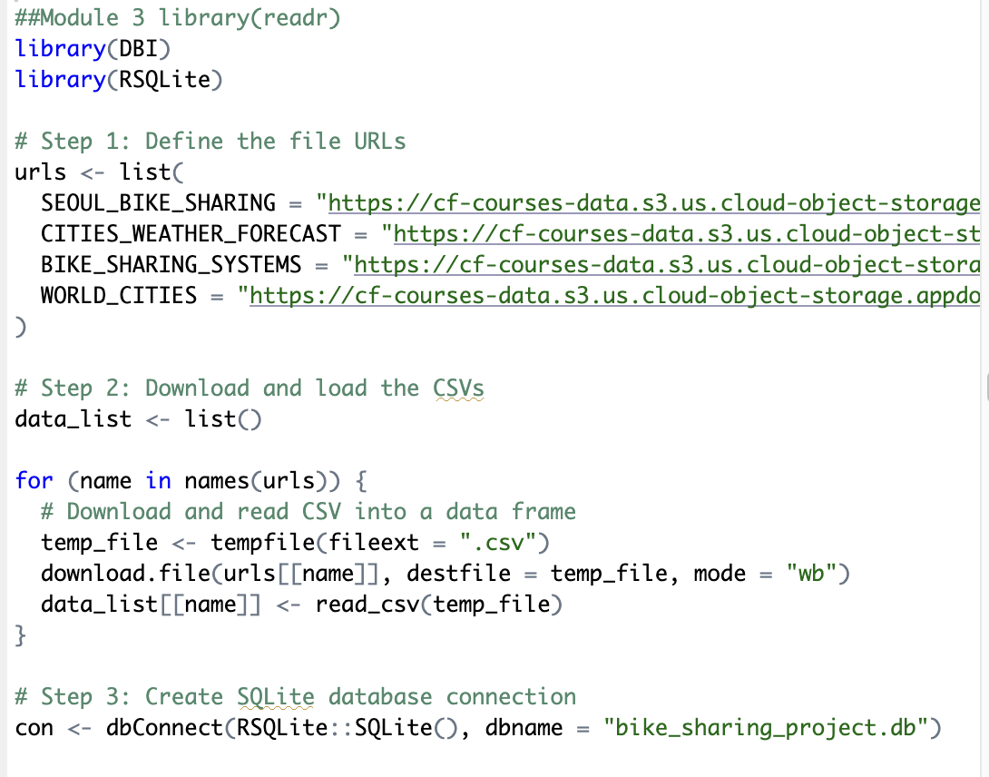
EDA with SQL
Queried and aggregated data using SQL
Explored patterns in rental count, temperature, and seasonal variation
Visualized trends using ggplot2 in R

Slide 16
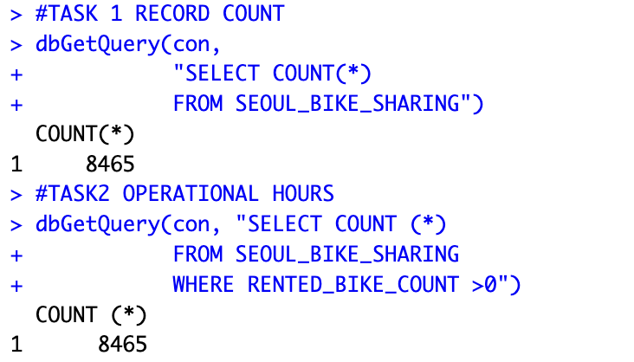
Task 1

Slide 17
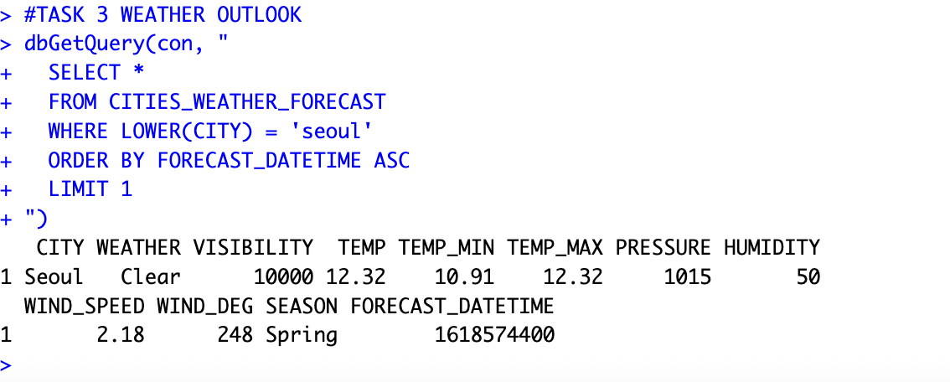
We queried the CITIES_WEATHER_FORECAST table to extract the earliest forecast

Slide 18
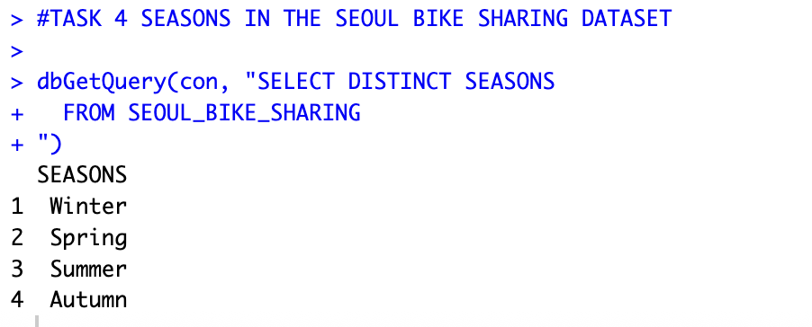
We used R functions like dbListTables() and dbListFields() to confirm table and column names within the SQLite database. This step ensured accurate querying and helped avoid SQL errors like referencing non-existent columns (e.g., mistakenly using DATE instead of FORECAST_DATETIME).

Slide 19
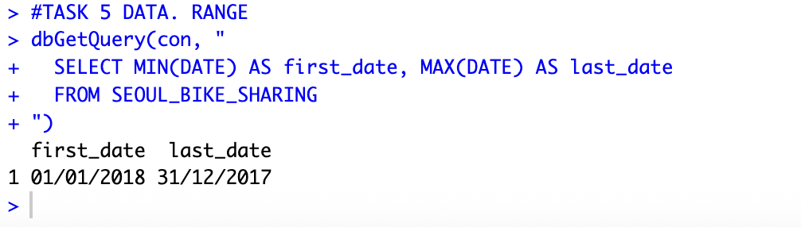
This task would involve joining SEOUL_BIKE_SHARING and CITIES_WEATHER_FORECAST on a common timestamp to analyze how real-time weather influences hourly bike rentals. It would allow us to build predictive models or visual dashboards using ggplot2 or Shiny.

Slide 20
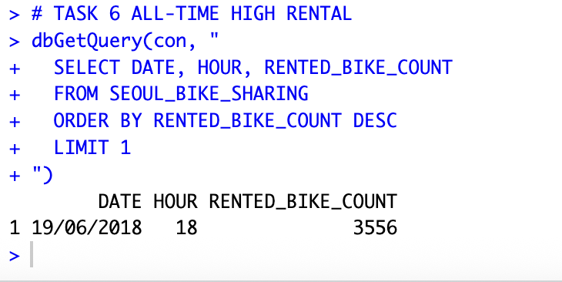
Identified the peak demand hour in the SEOUL_BIKE_SHARING dataset by selecting the record with the highest number of bikes rented. This helps reveal when demand reaches maximum capacity, which is valuable for operational planning and surge management.
Insight: Highlights the busiest hour historically, which could guide bike redistribution or fleet scaling.

Slide 21
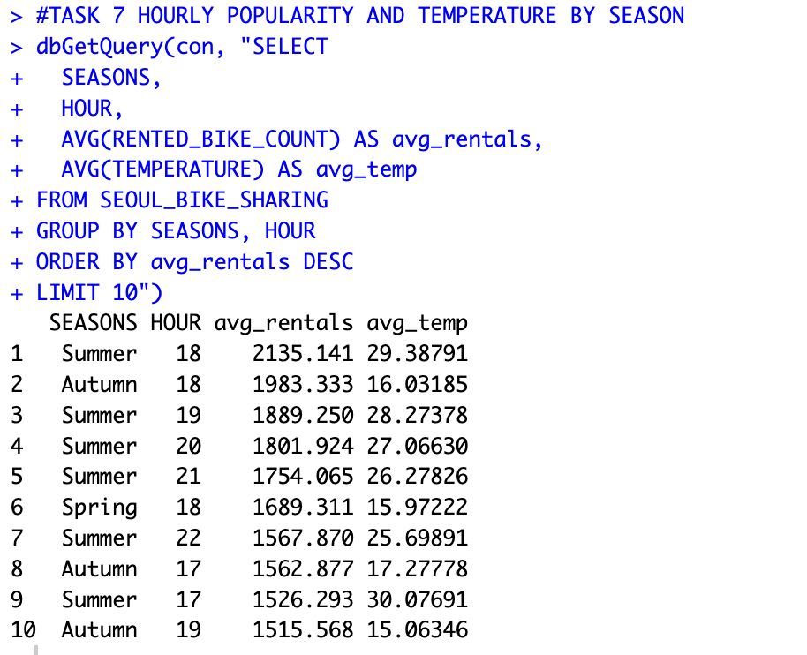
Aggregated bike rental data by hour and season to calculate the average rentals and average temperature for each combination. This analysis shows which hours are most popular across seasons, revealing patterns in both usage and weather influence.
Insight: Uncovers peak rental hours for each season and how temperature correlates with demand.

Slide 22
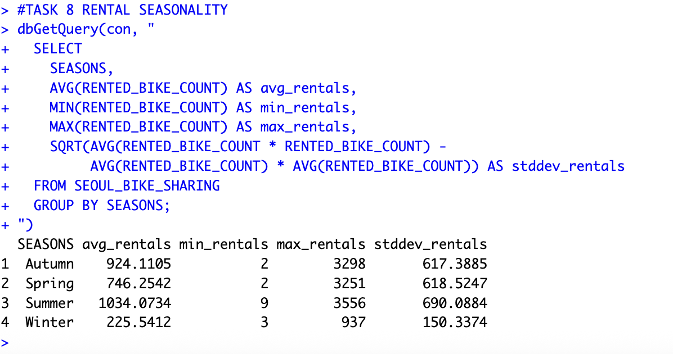
Calculated seasonal trends in bike rentals, including:
Average rentals
Minimum and maximum rentals
Standard deviation (volatility)
This helps assess both typical usage and variability across seasons.
Insight: Quantifies the consistency and fluctuation of bike demand throughout the year.

Slide 23
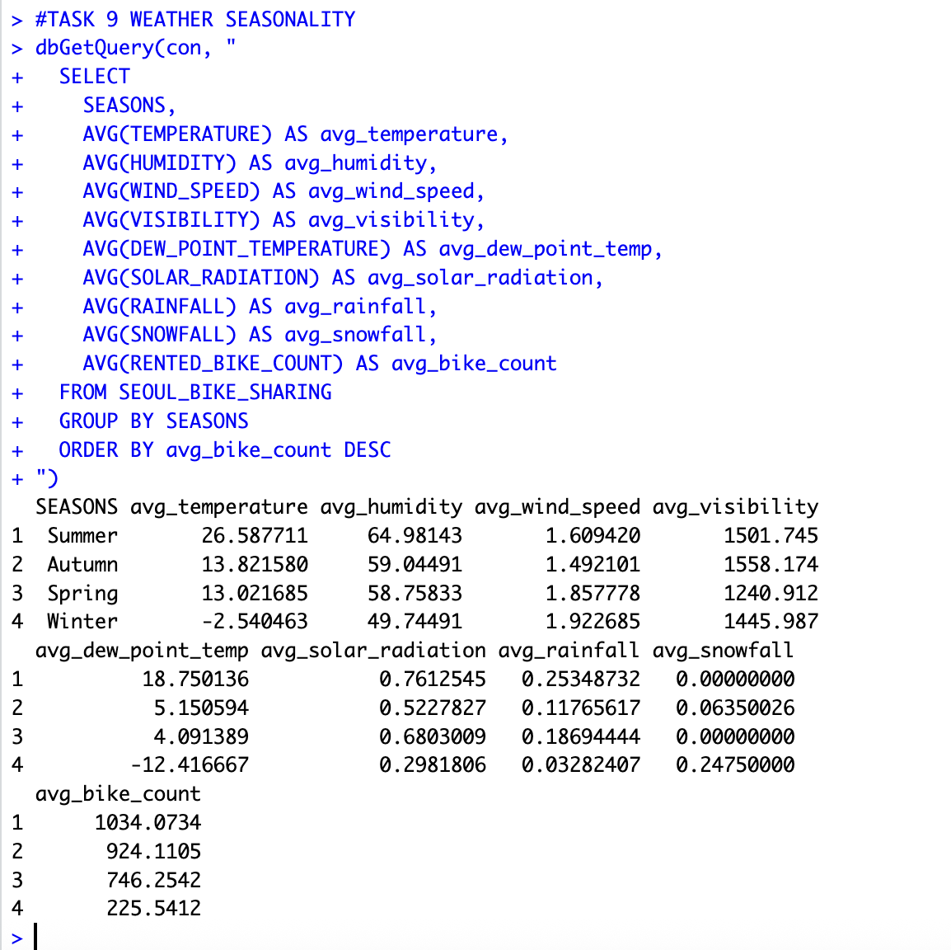

Slide 24
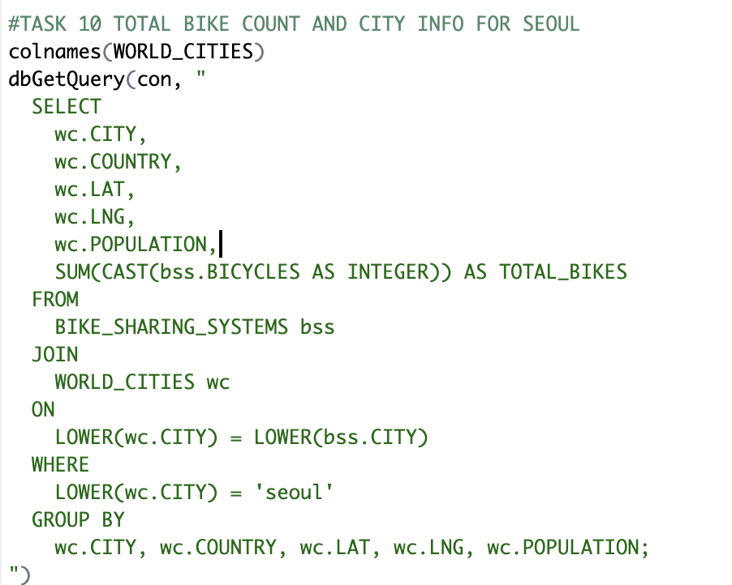
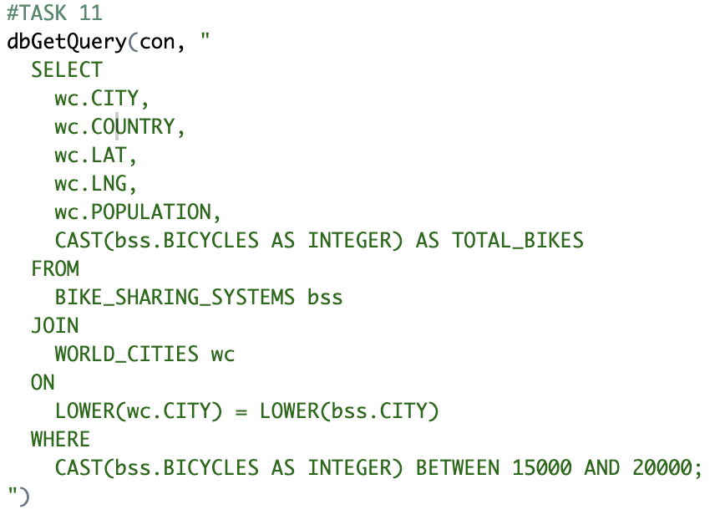

Slide 25
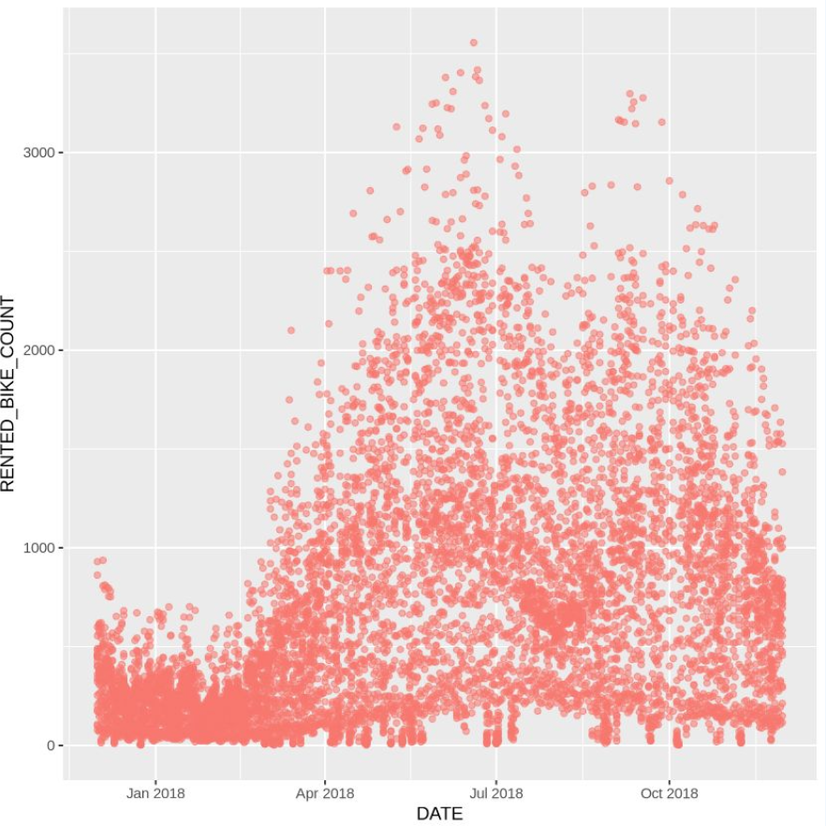
Bike Rental vs Date
Rising Trend in 2018: There is a noticeable increase in rental activity starting in early 2018, with a higher density of points above 1,000 rentals per day. This suggests growing adoption or seasonal promotion of bike-sharing services.
Peak Periods: The highest concentration of rentals appears between May and September 2018, likely due to favorable weather and increased outdoor activity in summer.
High Demand Outliers: Several extreme values exceed 3,000 rentals in a single day, highlighting moments of surge demand, possibly due to holidays, events, or ideal weather conditions.

Slide 26
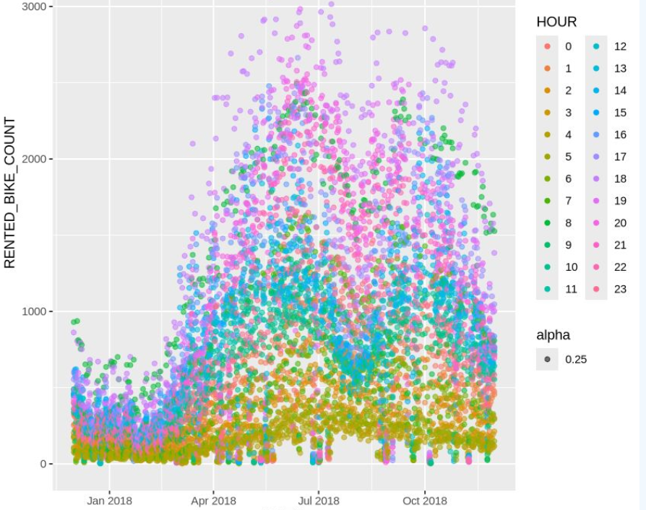
Bike Rental vs Datetime
Color Separation by Hour: Midday hours (especially 12 PM to 4 PM, shown in pinks and purples) dominate peak rental periods. These hours show up higher on the Y-axis, indicating strong demand.
Seasonal Pattern Consistency: The surge in overall bike rental volume during spring and summer (Apr–Sep) is consistent across most hours. Evening hours (e.g., 17–20) remain moderately active even in cooler months.
Dense Clustering at Lower Rentals: Early morning (e.g., 0–6 AM) and late-night hours show lower rental counts, clustering near the bottom regardless of date.
Temporal Trends: From early 2018 through October, activity is clearly growing, with more high-rental points appearing later in the year.

Slide 27
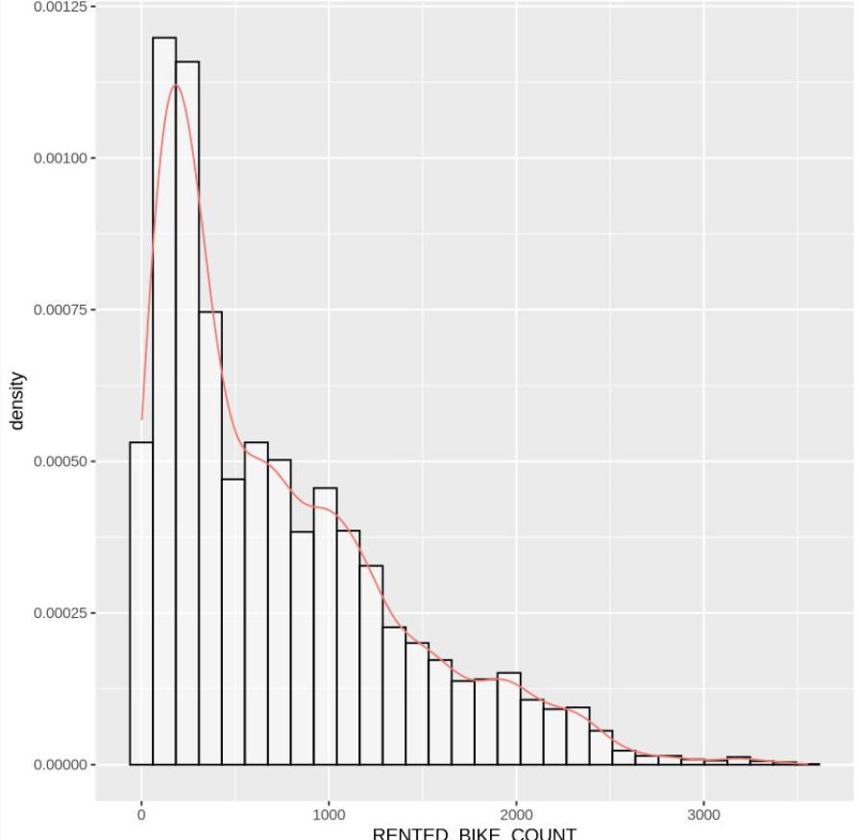
Rental Histogram
Right-Skewed Distribution: The chart clearly shows a positive skew, where most rental counts are concentrated on the lower end (between 0 and 1,000 rentals per hour), and fewer observations occur at higher values.
Most Frequent Rental Range: The peak occurs between 300–600 rentals/hour, representing the most common rental levels across all hours and dates.
Long Tail of High Rentals: There is a long tail stretching beyond 3,000 rentals/hour, suggesting rare but significant surges in demand—possibly during peak hours, seasons, or public events.
Density Line (red): The red curve provides a smoothed approximation of the underlying distribution, confirming that the rental counts do not follow a normal distribution.

Slide 28
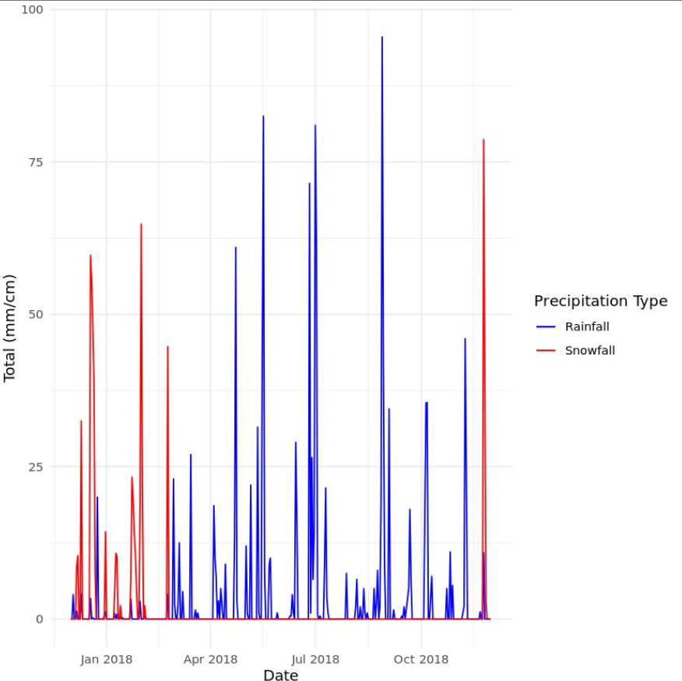
Rainfall vs Snowfall
Winter Snowfall: Significant snowfall events are concentrated between December and February, aligning with Seoul’s coldest months. The peaks are sharp and intermittent.
Summer Rainfall: Rainfall becomes dominant from May to August, with frequent and higher-volume rain events. Several spikes exceed 75 mm, indicating monsoon season.
Minimal Overlap: There's a clear seasonal separation — snowfall and rainfall rarely occur together, reinforcing the distinct climate phases.
End-of-Year Spike: A sudden return of snowfall in late November to December suggests the start of the next winter cycle.

Slide 29
Predictive analysis
Built multiple linear regression models:
Baseline Model: using weather variables only
Improved Model: added interaction terms and polynomial features
Regularized Model (GLMNet): for better generalization
Evaluated using R² and RMSE on test data

Slide 30
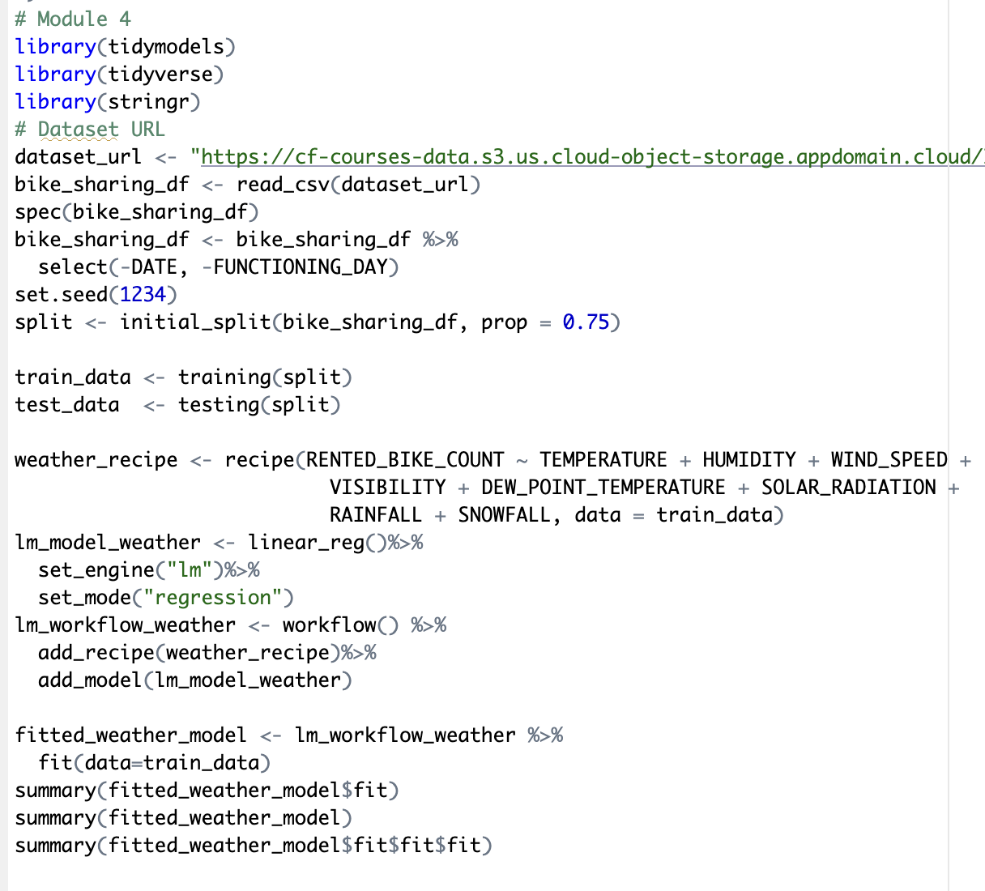

Slide 31
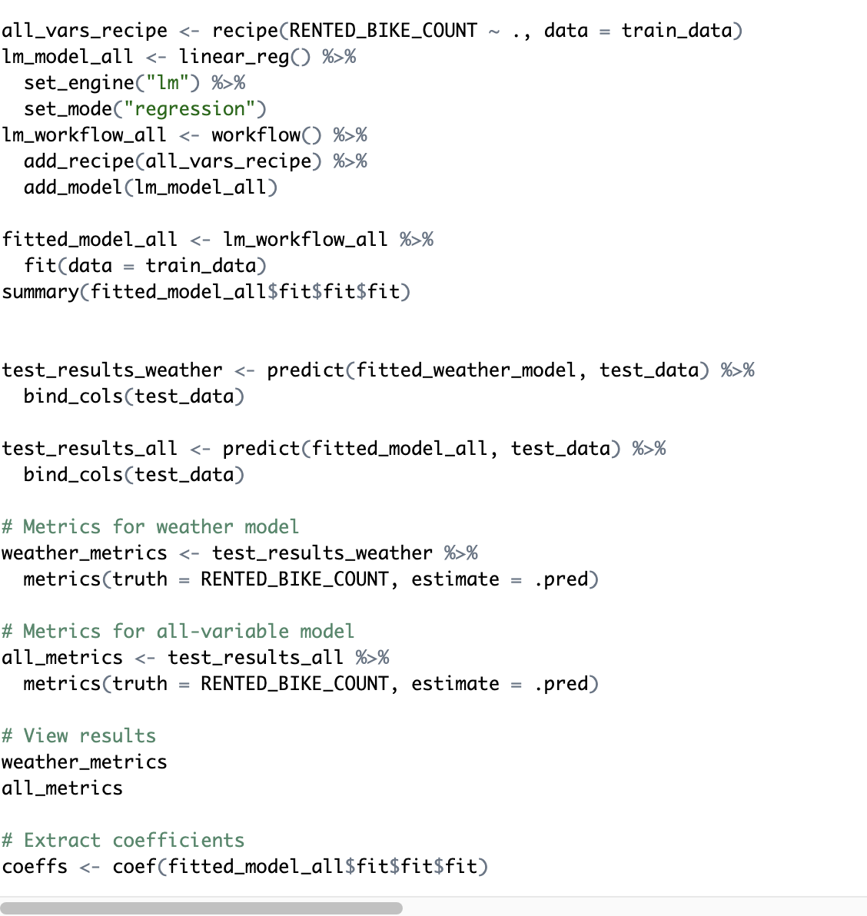

Slide 32
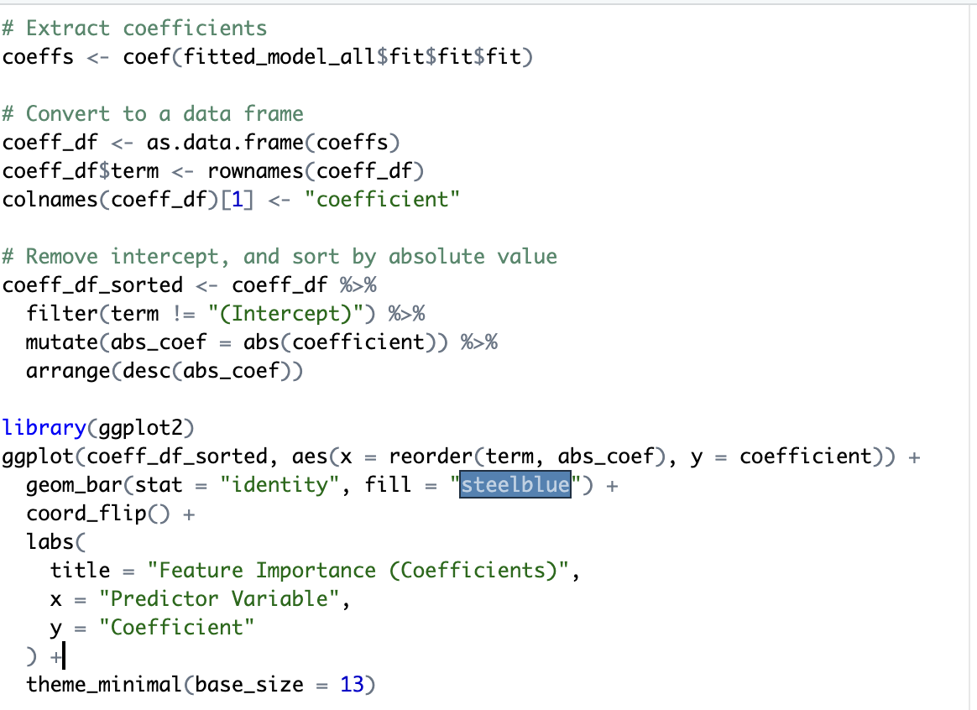

Slide 33
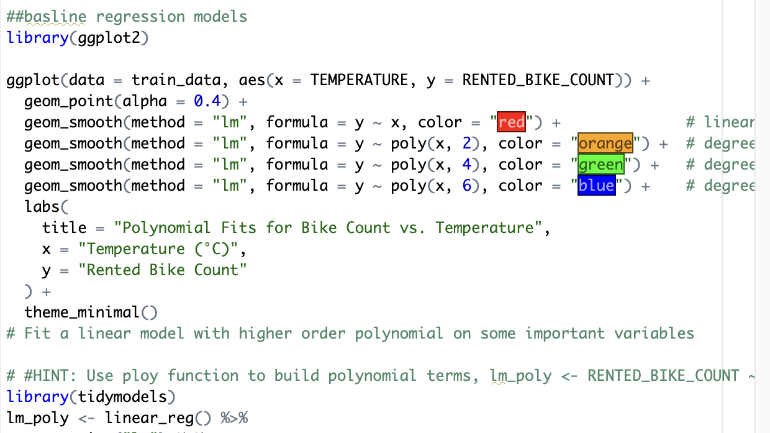

Slide 34
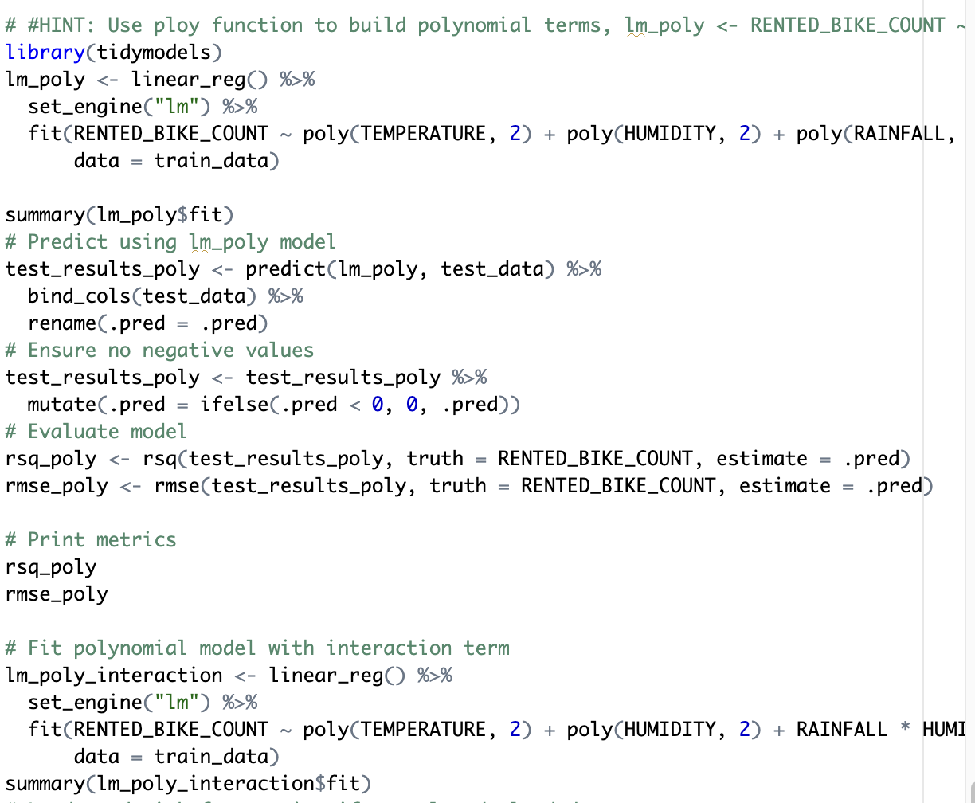

Slide 35
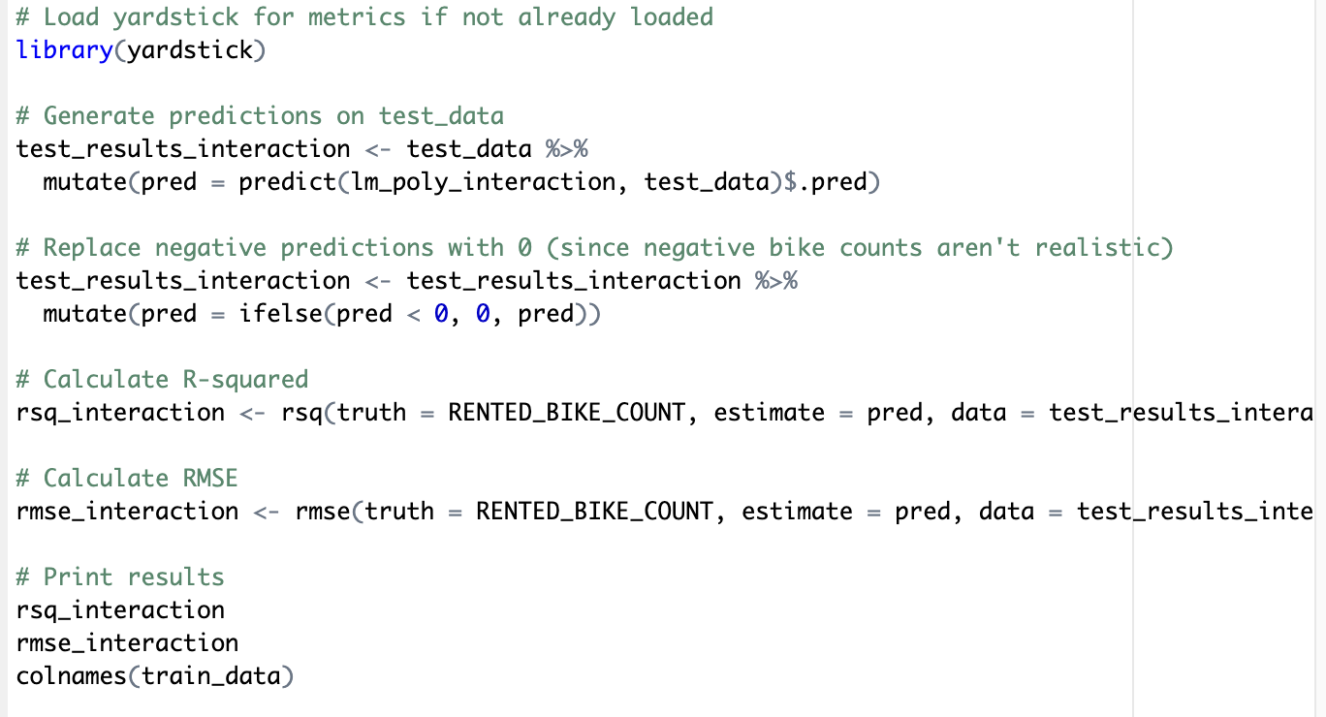

Slide 36
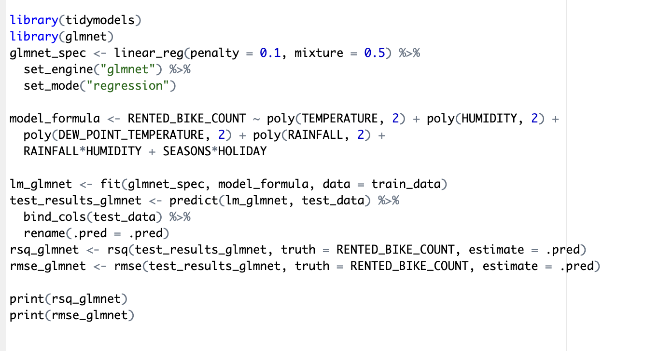

Slide 37
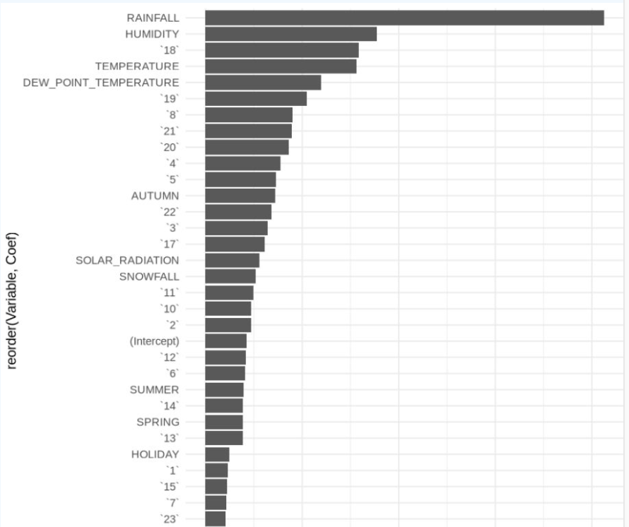
Ranked Coefficinet
🌧️ Rainfall has the strongest negative influence, suggesting that as rainfall increases, bike rentals drop significantly.
💧 Humidity and temperature also play important roles, likely affecting rider comfort and decision-making.
❄️ Dew point temperature—a proxy for atmospheric moisture—further impacts perceived air quality and ride feasibility.

Slide 38
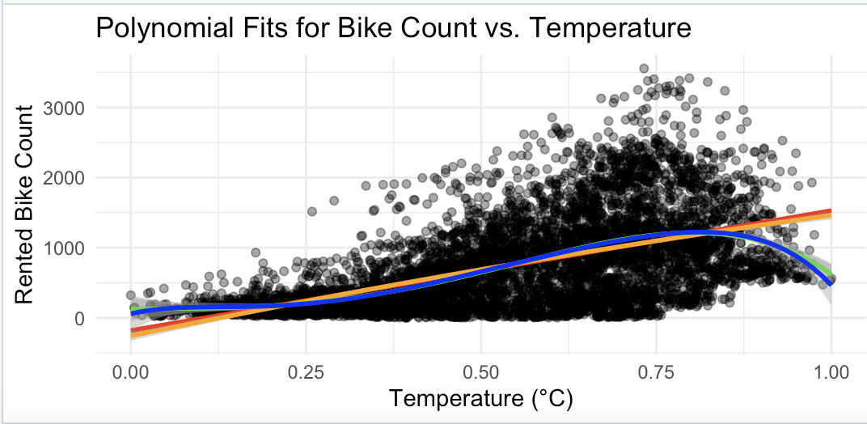
Models
🔍 Key Insights:
General Trend: Bike rental count increases with temperature up to a point, peaking between normalized values of ~0.75–0.85(likely corresponding to 20–25°C), after which demand slightly decreases—possibly due to discomfort in high heat.
Polynomial Fits:
The red, blue, and orange lines represent polynomial regressions of increasing degrees (e.g., linear, quadratic, cubic).
The higher-degree polynomials (blue and orange) capture the rise and fall in rental activity more accurately than a linear model.
Overfitting Caution: While higher-degree polynomials better fit the data, they risk overfitting — capturing noise rather than the general trend. The best model should balance accuracy and generalizability.

Slide 39
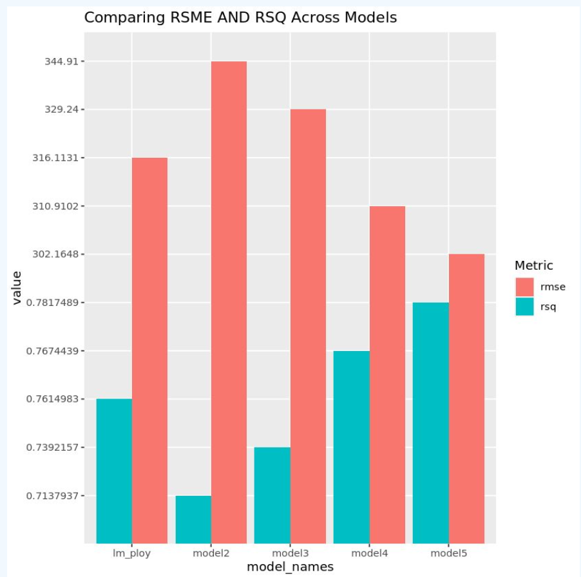
Models
Best Performing Model: Model 5 achieves the lowest RMSE and the highest R², making it the most accurate and reliable model overall.
Worst Performing Model: Model 2 has the highest RMSE and lowest R², indicating poor predictive power and high deviation from actual rental counts.
Consistent Improvement: There’s a clear improvement in both metrics from Model 2 → Model 5, suggesting that refinements such as feature engineering or algorithm tuning were effective.
lm_ploy Baseline: The lm_ploy model shows reasonable performance, serving as a polynomial regression benchmark, but is outperformed by later models in both metrics.

Slide 40
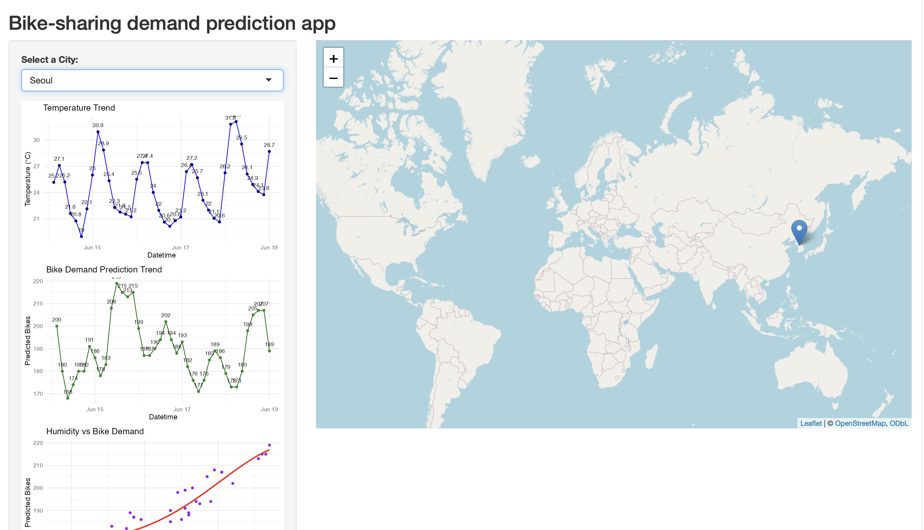
Build a R Shiny dashboard

Slide 41
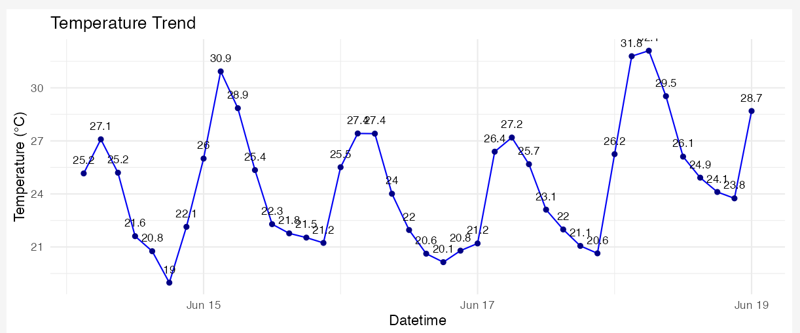
Seoul

Slide 42
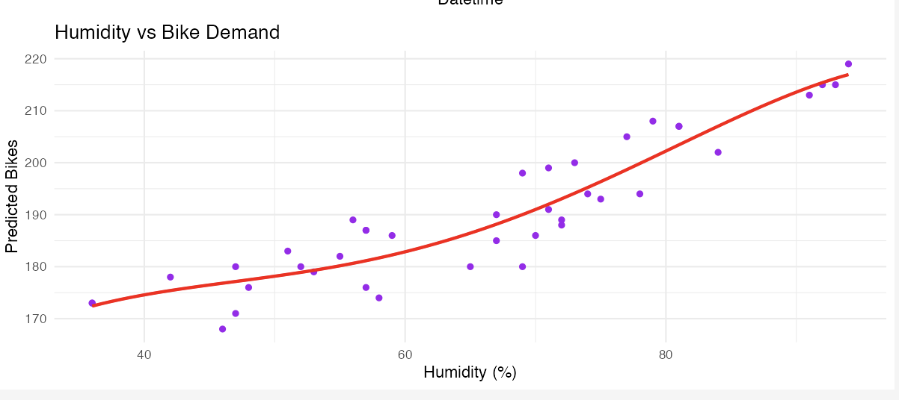
Seoul

Slide 43
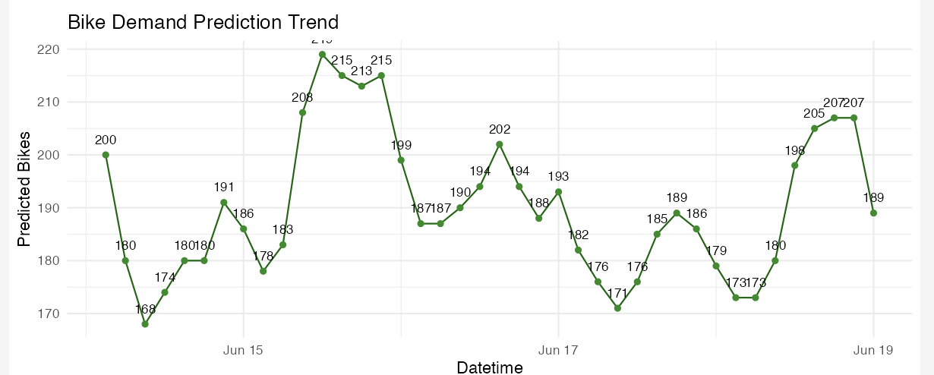
Seoul

Slide 44
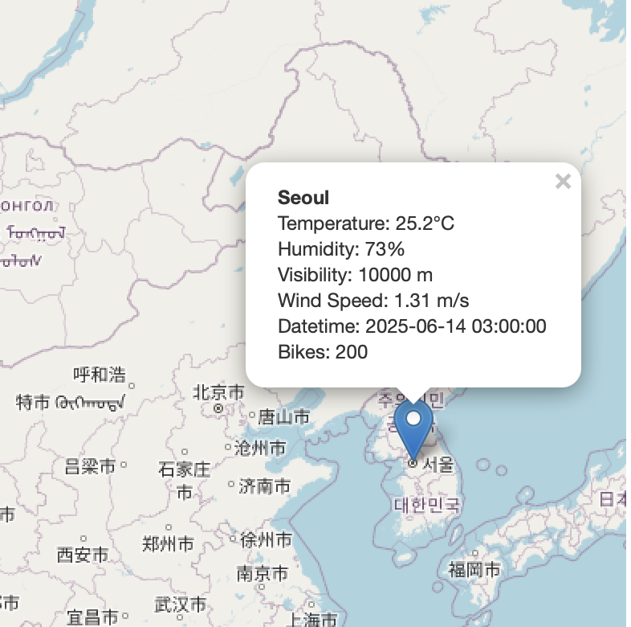

Slide 45
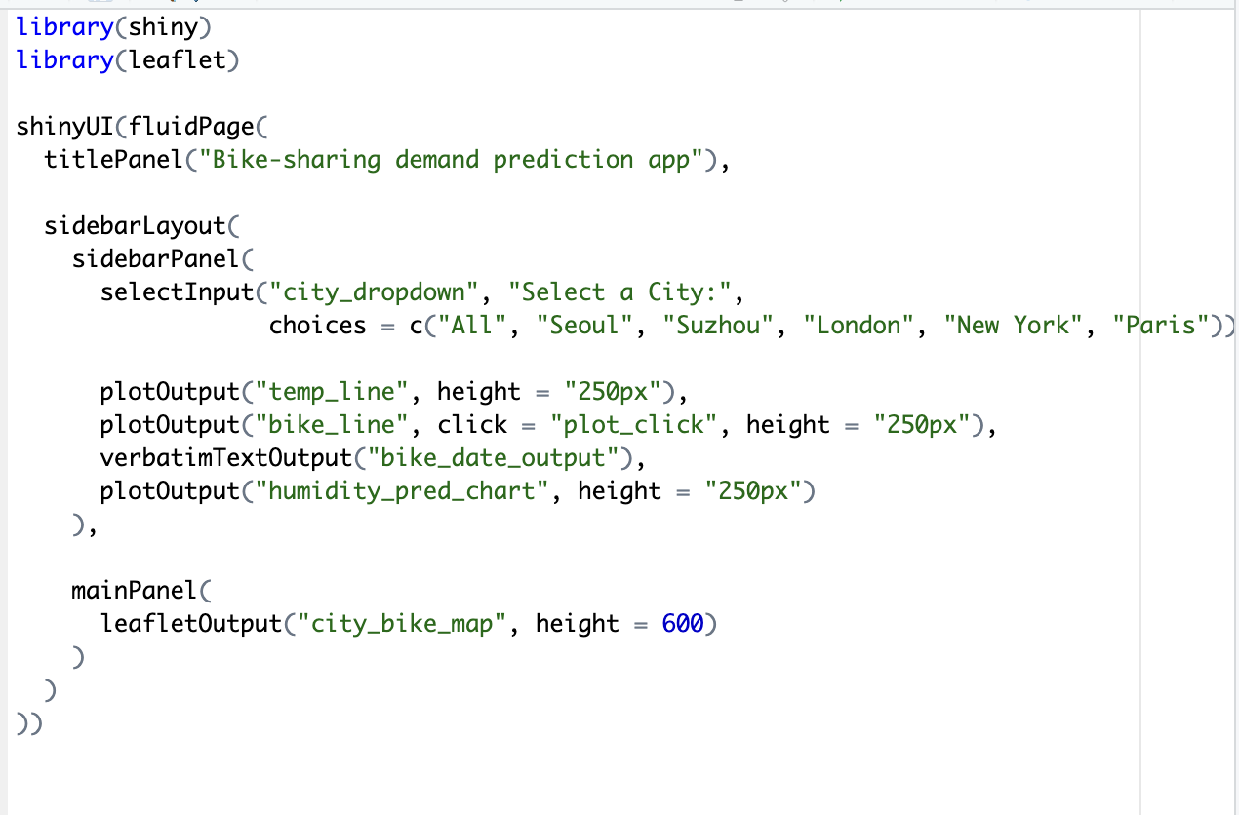
Shiny - ui

Slide 46
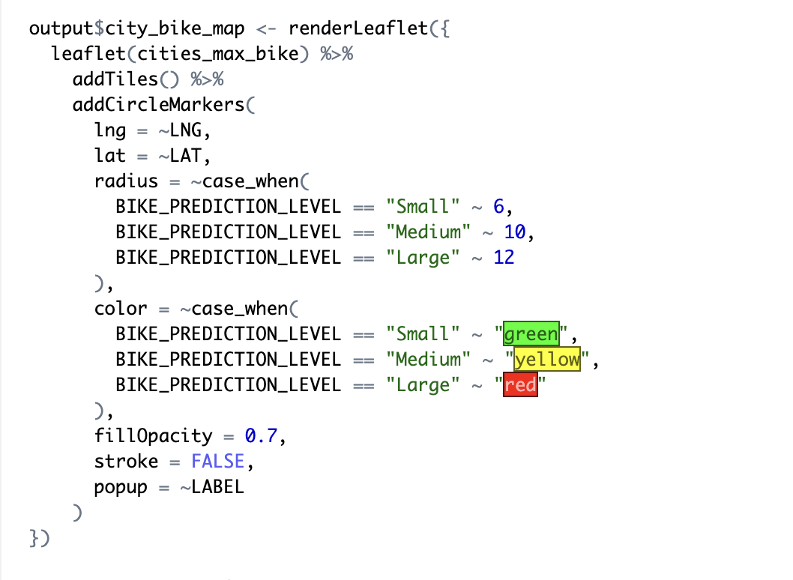
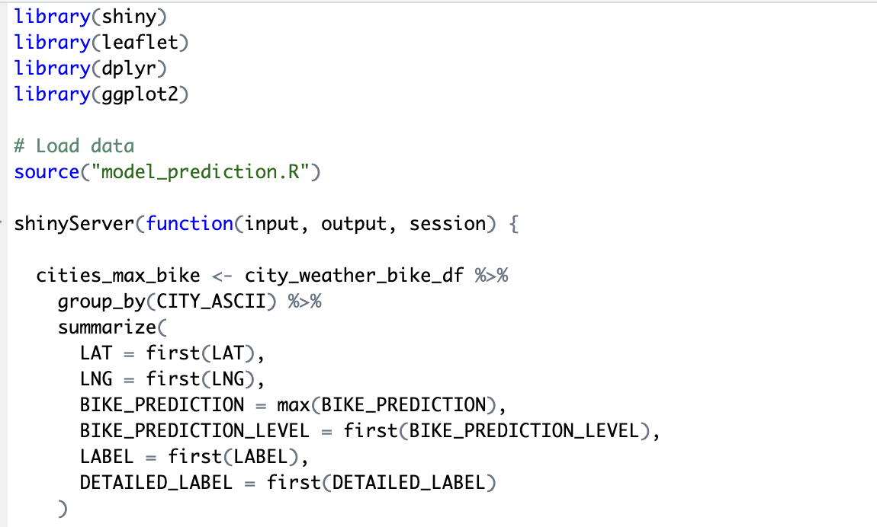
Shiny Server

Slide 47
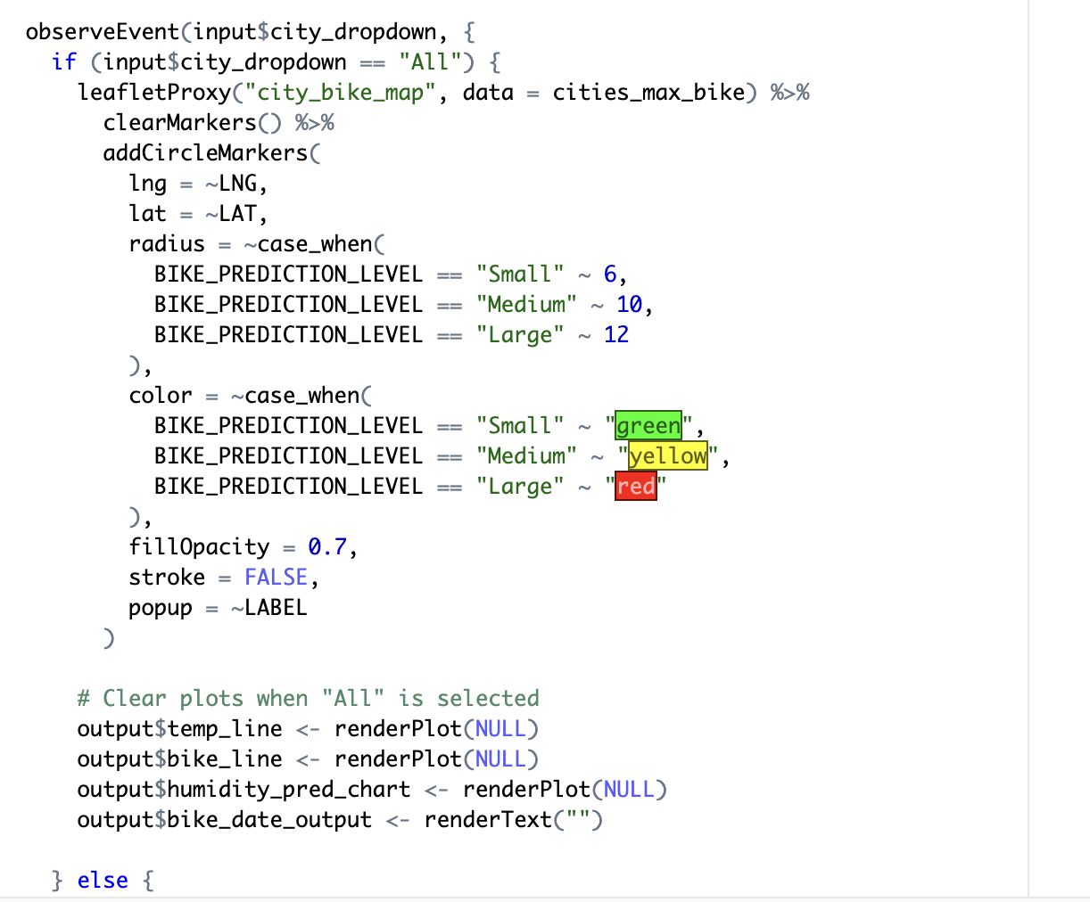
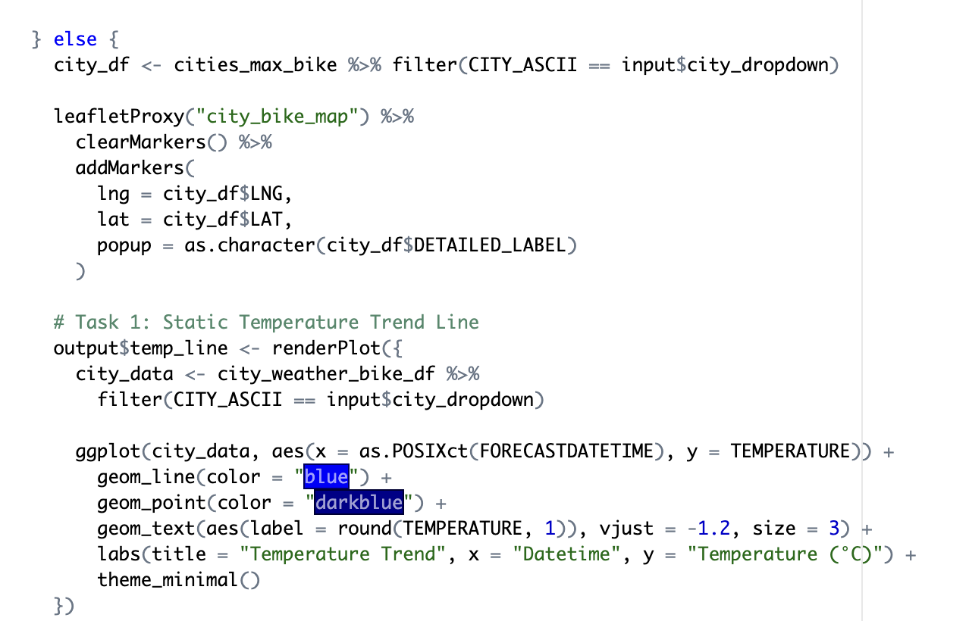
Server cont

Slide 48
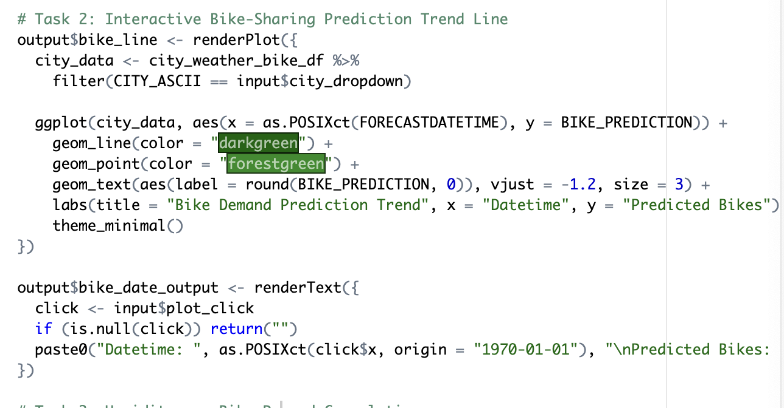
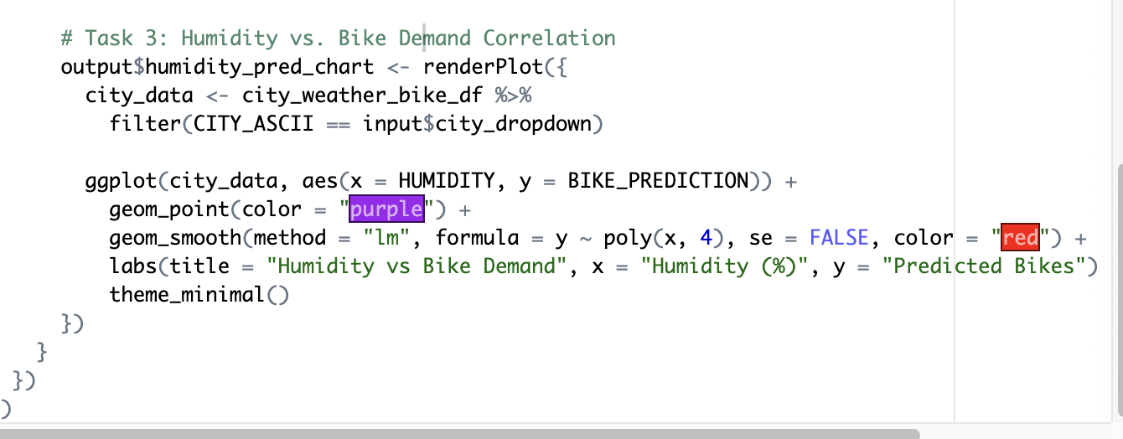
Server cnt 2

Slide 49
Conclusion
Integrated open data, APIs, and SQL/R tools to analyze bike-sharing demand
Identified key drivers of demand: temperature, humidity, solar radiation, and seasonality
Built predictive models using regression techniques
Achieved high R² and low RMSE with improved models
Demonstrated strong potential for demand forecasting and resource optimization
Supports data-driven decisions in sustainable urban mobility
Future directions: real-time forecasting, R Shiny dashboard, time-series modeling

